Slide 1

FilmLane

Slide 2

Group Members
Introduction
CONTENTS
Tools
Scope

Slide 3
1
Group Members

Slide 4
FilmLane
Names

Slide 5
2
Introduction

Slide 6
FilmLane
FilmLane Movie app Website is a social video streaming website on which people can watch the videos, like/dislike, and comment on the videos etc. Create a common place for movies , series , TV Shows in multiple languages.

Slide 7
3
Tools

Slide 8
FilmLane
HTML
CSS
JAVASCRIPT
PHP
VISUAL STUDIO CODE

Slide 9
4
Scope

Slide 10
FilmLane
Scope of this product include the development of a good database and an attractive interface so that people can easily use it. The user also has the facility to see the list of Movies and Tv Serials which they had watched previously recommended Movies and Tv Serials. People love TV content, but they don't love the linear TV experience, where channels present programs only at times on non-portable screens with complicated remote controls.
Now Movie App Website which is on-demand, personalized, and
available on any screen - is replacing linear TV

Slide 11
Website

Slide 12
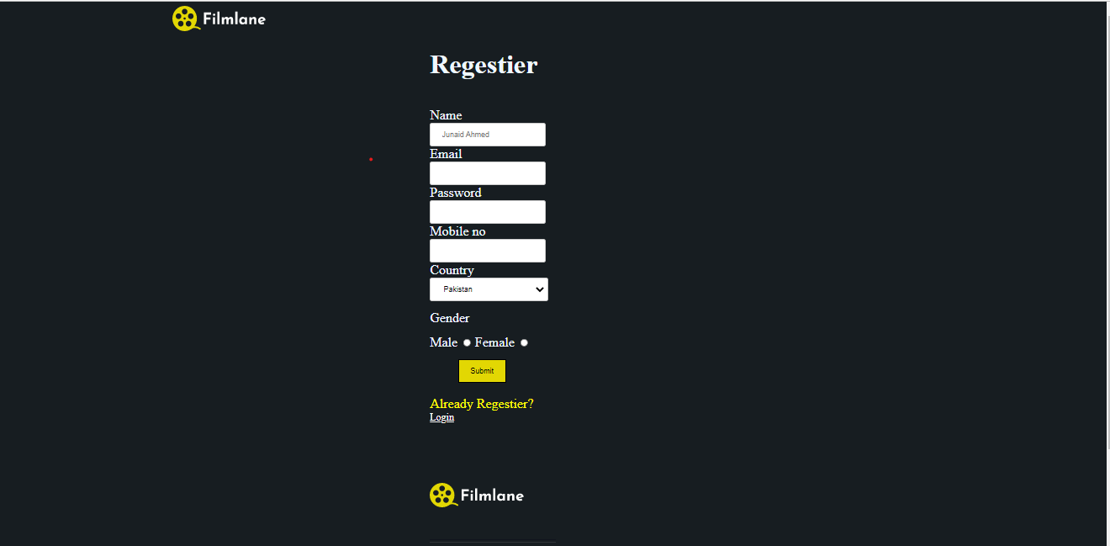
FilmLane
First user Register himself/herself for using websites

Slide 13
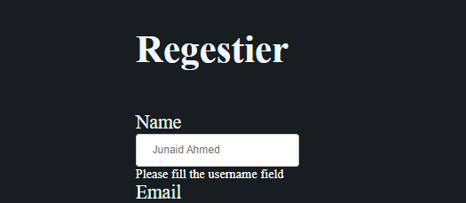
FilmLane
For Registration the user fill all the fields if he not fill he will not register himself/herself and he will not watch the movies

Slide 14
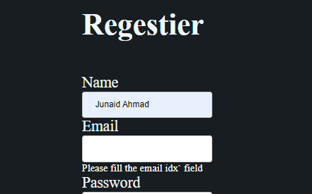
FilmLane
The validation is on every field so you can enter the data in all fields than you will able to register otherwise you are not

Slide 15
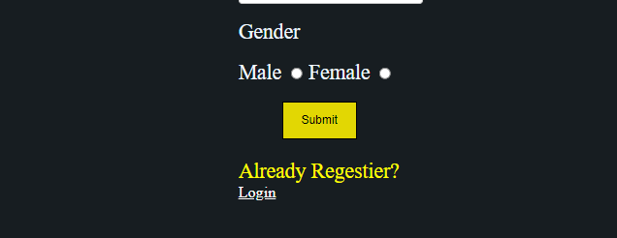
FilmLane
If the user already register himself/herself on this website than go to login page and login himself/herself and watching the movies

Slide 16
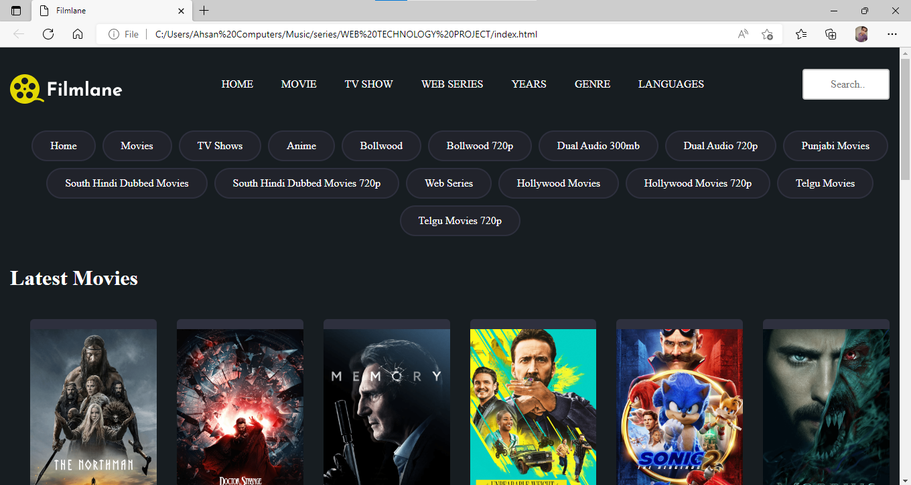
FilmLane
After login the user come to home page of website where user choose which type of movie user want

Slide 17
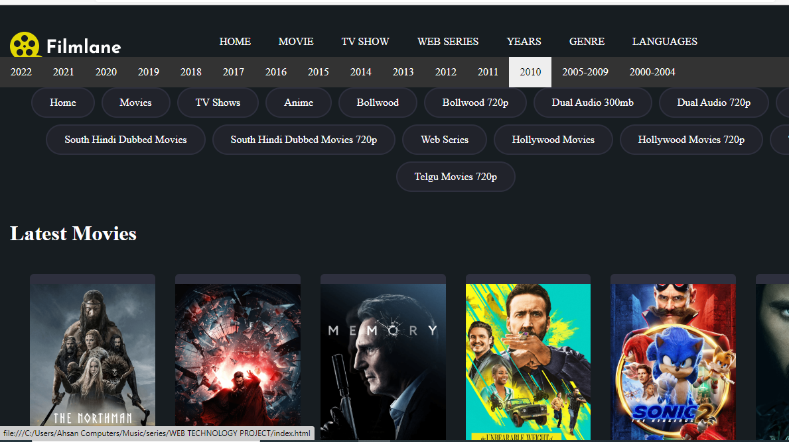
FilmLane
Here we create a category of years where users select the year and watch selected year movies

Slide 18
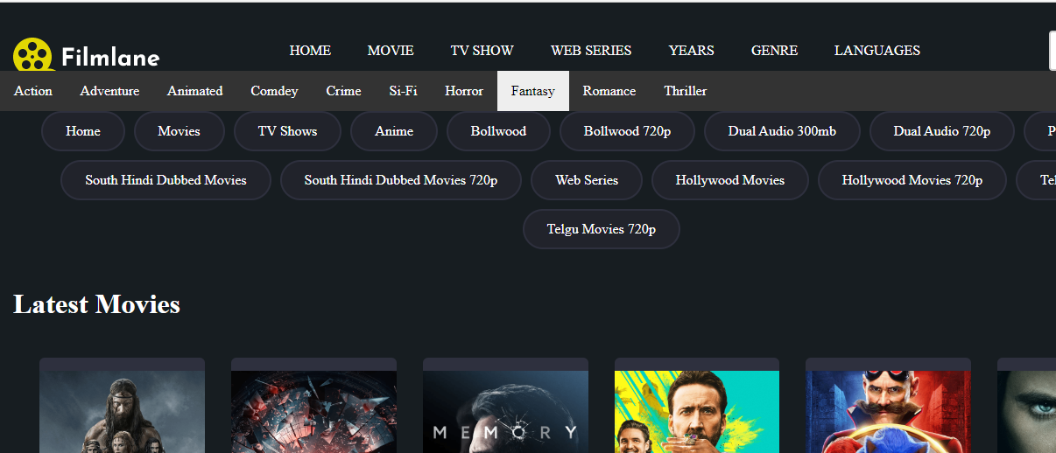
FilmLane
Here we create a category of genre where users select the genre that he like action , adventure, comedy, sci-fi, animated, romance movies

Slide 19
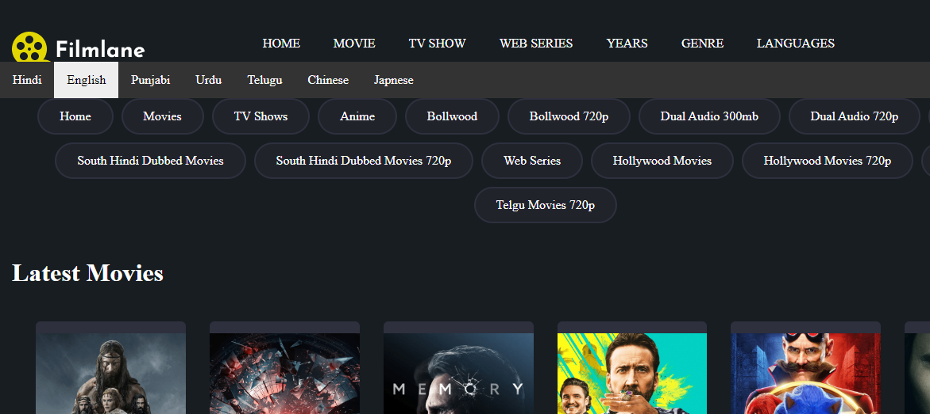
FilmLane
Here we also create a category of language where users select the Language

Slide 20
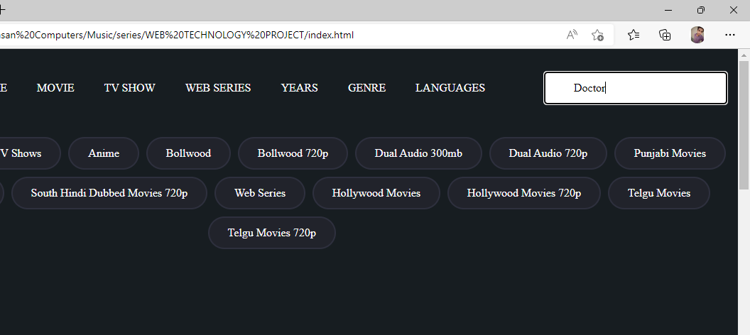
FilmLane
Here we create a search bar where user search the movie

Slide 21
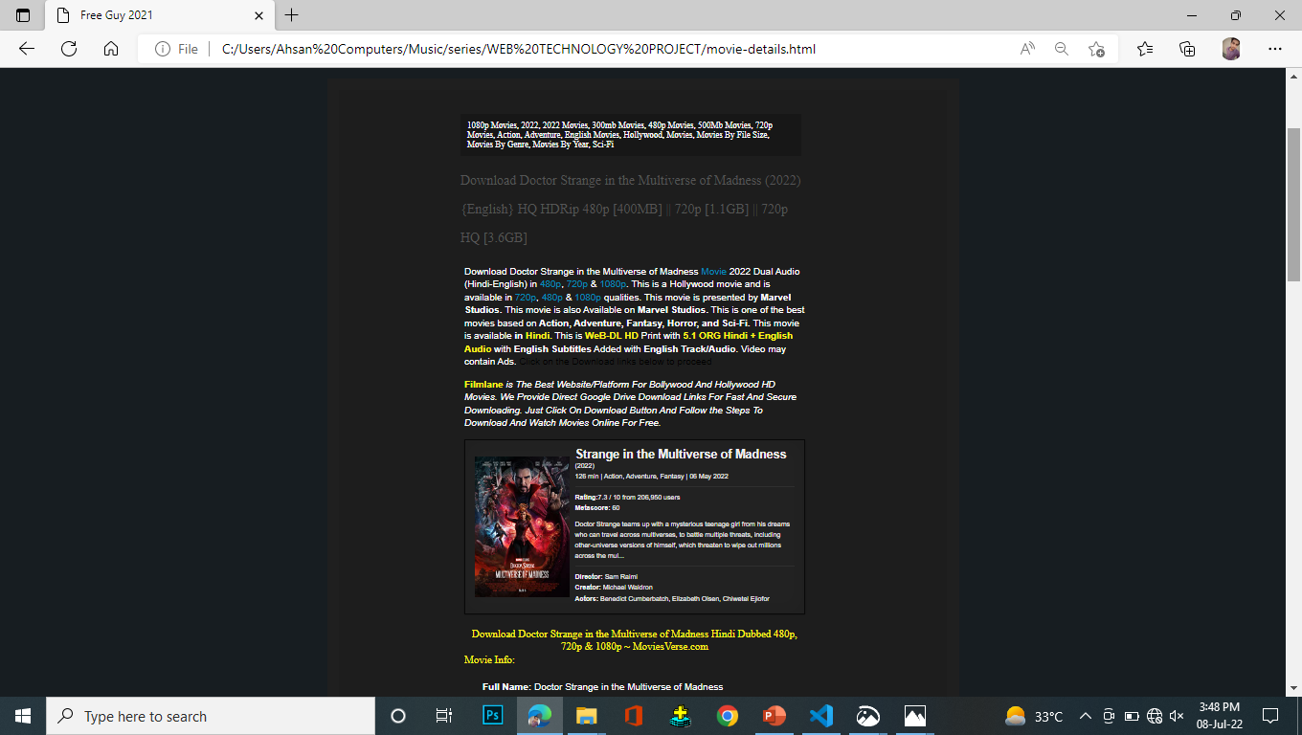
FilmLane
When user choose the movie and click on to watch the movie than he go to next page

Slide 22
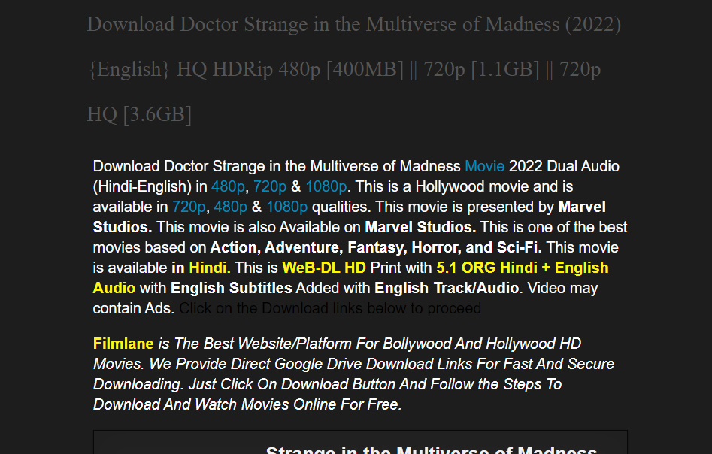
FilmLane
Here we give a description of movies that this movie is presented by this studio, this movie is action or horror or comedy and here we also describe that this movie is which languages

Slide 23
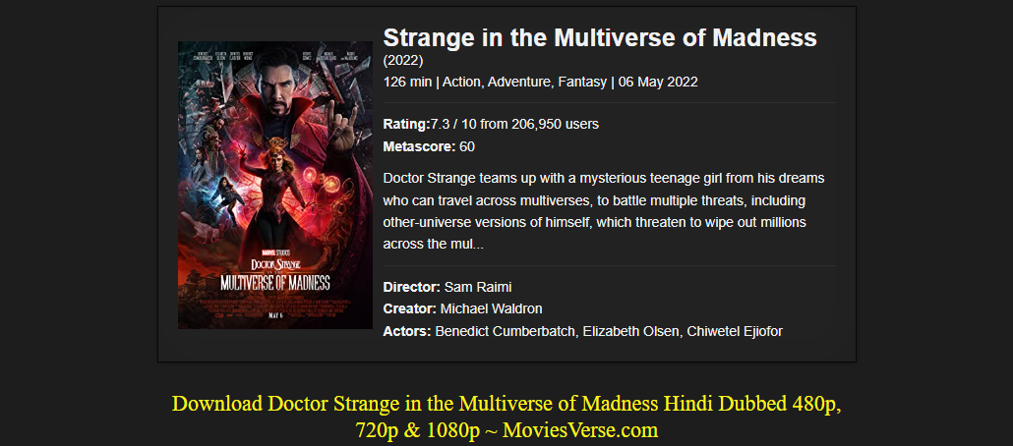
FilmLane
After description we also give the details of movie actors director and creator and tell the rating of movie , also tell run time,

Slide 24
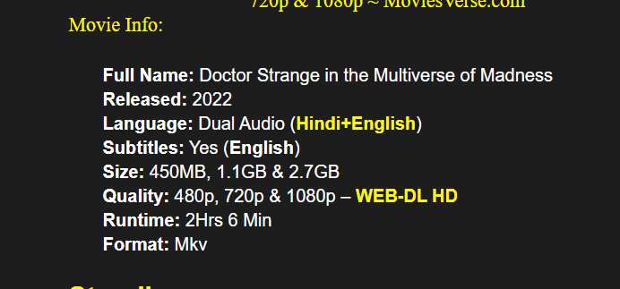
FilmLane
We also give the movie info like size, quality, subtitles ,languages

Slide 25
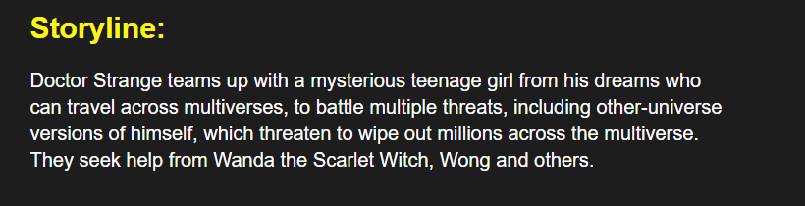
FilmLane
After the movie info we give storyline of movie

Slide 26
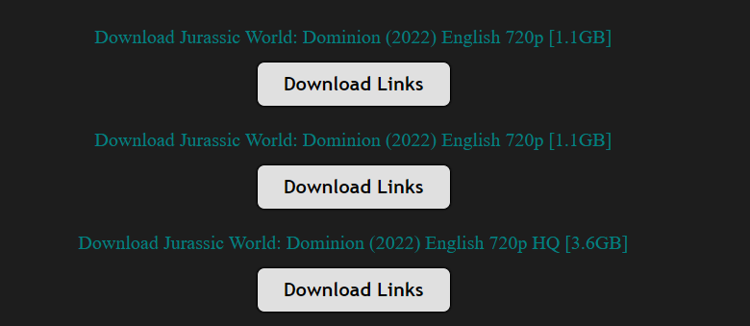
FilmLane
After all of this we give download links where the user choose the size of the movie and quality .

Slide 27
FilmLane
After choose the size and quality user click on download links when he click the button after click on button the user go to new page and then user select the g-direct file when he click the g-direct the user go to google drive where the movie upload and the download option is come and user click on the download button

Slide 28
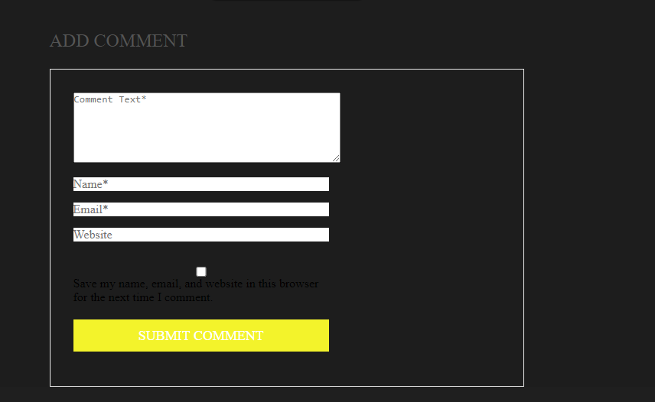
FilmLane
After all of this we create a comment section where user comment

Slide 29
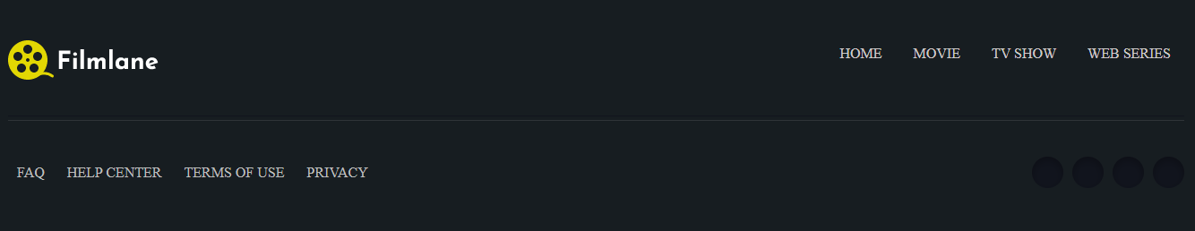
FilmLane
At the end we create a session where if user want help, know about terms of use and privacy

Slide 30
FilmLane
At the end we also give the links of our social platforms links

Slide 31
THANK YOU !

